Slide 1


Aspect Based Sentiment Analysis for Food Industry
Date: 21st January 2026

Slide 2
Aspect based sentiment analysis (ABSA) for Food and Nutrition Industry – Problem Statement
Problem Statement:
To analyze customer feedback and social media interactions about food and nutrition products to:
Identify key aspects (e.g., taste, packaging, affordability, health benefits) mentioned in user-generated content.
Determine the sentiment (positive, neutral, or negative) associated with each aspect.
Enrich the analysis with product metadata (e.g., categories, ingredients) to provide deeper insights into customer preferences and concerns.
The goal of this exercise is to develop a comprehensive Sentiment Analysis framework that leverages diverse data sources to extract actionable insights about products in the food and nutrition industry.
The solution aims to address the following challenges:

Slide 3
Example :
❌ Traditional Sentiment
Review:
'I like the taste and it does not feel artificial but price is expensive but considering the nutrition values price is ok and package looks attractive.'
Model Output : Neutral
No actionable insight.
✅ Aspect-Based Sentiment (ABSA)
Review:
'I like the taste and it does not feel artificial but price is expensive but considering the nutrition values price is ok and package looks attractive.’
ABSA Output:
Taste → Positive
Natural Feel → Positive
Price → Negative
Value for Money → Positive
Packaging → Positive
Actionable insights per aspect!

Slide 4
Leveraged Data Sources for the analysis
Product Metadata:
Internal data about products, including:
Product ID
Product Name
Category (e.g., Nutrition, Food)
Ingredients (e.g., Whey Protein, Almonds, DHA)
This metadata provides context for analyzing customer feedback and allows grouping by product characteristics, such as nutritional content or food type.
Product Reviews:
Web-scraped reviews from e-commerce platforms or other sources.
Example: "The protein bar is tasty but a bit expensive."
Reviews are a rich source of direct customer feedback, often focusing on specific product features.

Slide 5
Solution Workflow
Data Collection
Aspect-Based Sentiment Analysis (ABSA)
Data Analysis
Visualization
Reporting and Recommendations
Deployment
Feedback Loop
Internal Metadata
Web-Scraped Product Reviews
Data Preprocessing
Text Cleaning
Date Formatting
Prompt Generation
Model Execution
Error Handling
Sentiment Trend Analysis
Aspect Co-occurrence Analysis
Sentiment Trend Analysis Plot
Aspect Co-occurrence Heatmap
Product Comparison Dashboard
Sentiment-Specific Word Clouds
Generate Reports
Recommendations
Automate Data Collection
Monitor and Update
Integrate with Business Systems
User Feedback
Model Fine-Tuning
Expand Scope
Aspect Importance Scoring
Aspect Importance Bar Chart
Data Collection
Data Preprocessing
Aspect-Based Sentiment Analysis
Data Analysis
Visualization
Reporting and Recommendations
Deployment
Feedback Loop

Slide 6
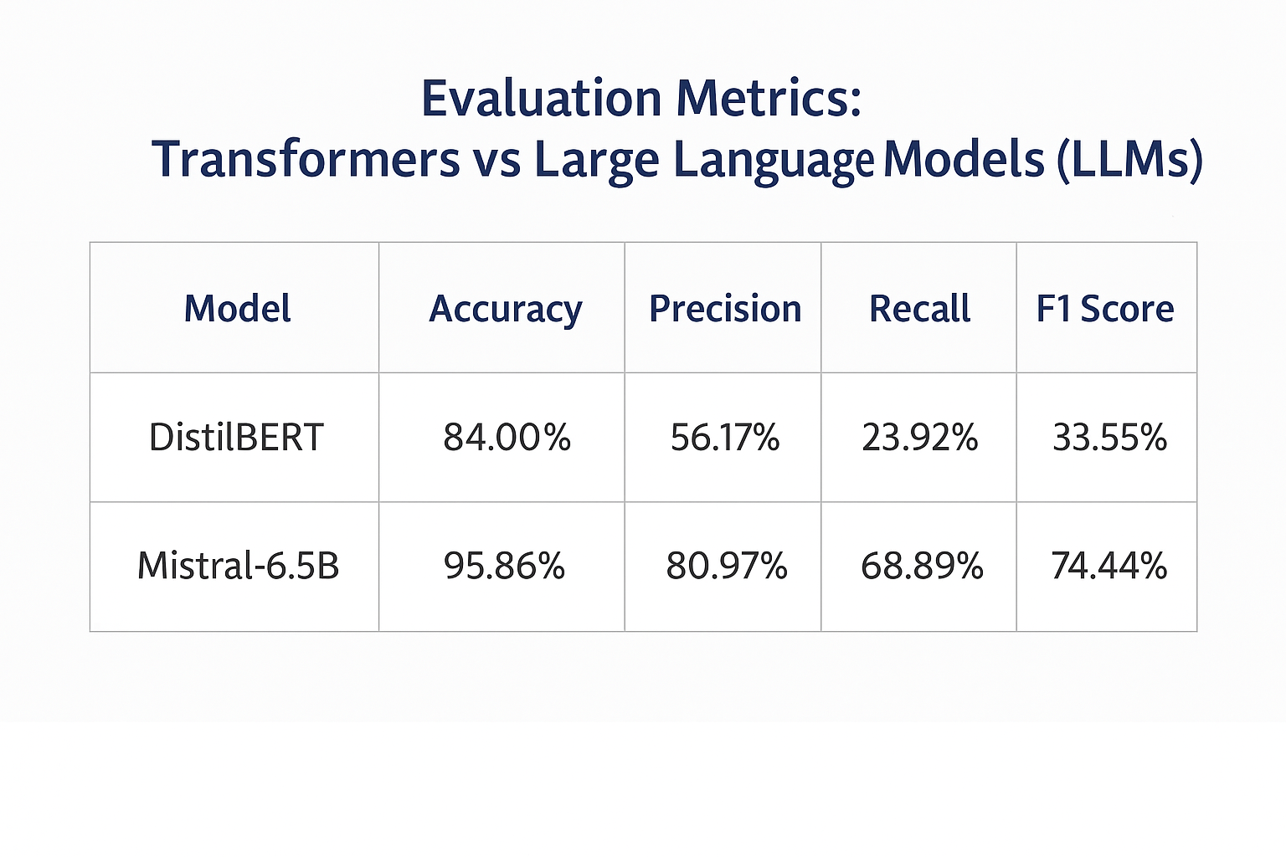
Performance Metrics: Transformers vs Large Language Models
LLaMA‑70B was used as the ground‑truth model for aspect and sentiment extraction. Using the same reviews, outputs from DistilBERT and Mistral‑6.5B were compared against LLaMA‑70B at the aspect‑sentiment level.
Results show that while DistilBERT achieves reasonable accuracy, it suffers from low recall and F1‑score, missing several aspects.
Mistral‑6.5B aligns much closer to the LLaMA‑70B outputs, delivering significantly better precision, recall, and overall F1‑score, making it more suitable for fine‑grained ABSA tasks.

Slide 7
Compare and Contrast Aspect based sentiment analysis (ABSA) with Sentiment analysis
Granularity of Analysis:
Sentiment Analysis: Focuses on determining the overall sentiment (positive, negative, or neutral) of a text as a whole.
ABSA: Analyzes sentiment at a finer level by identifying specific aspects or features within the text and determining sentiment for each aspect.
Complexity:
Sentiment Analysis: Relatively simpler as it does not require aspect extraction or detailed analysis of specific components.
ABSA: More complex as it involves identifying aspects, associating sentiments with them, and sometimes even determining their relationships.
Use Cases:
Sentiment Analysis: Suitable for gauging overall public opinion, brand reputation, or general customer satisfaction.
ABSA: Ideal for detailed feedback analysis, such as understanding customer opinions on specific product features or service attributes.
Data Annotation:
Sentiment Analysis: Requires general sentiment labels for the entire text.
ABSA: Requires more detailed annotations, including aspect terms and their corresponding sentiment labels.

Slide 8
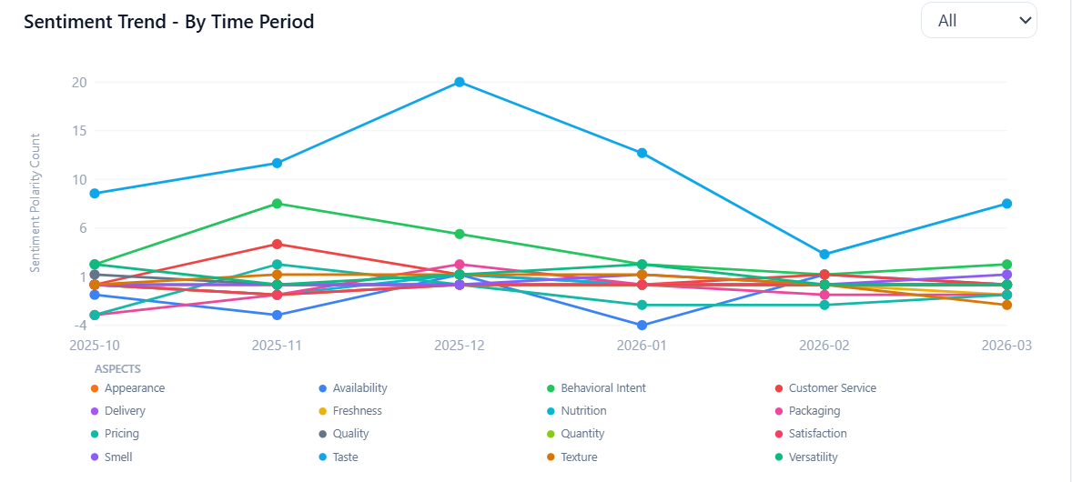
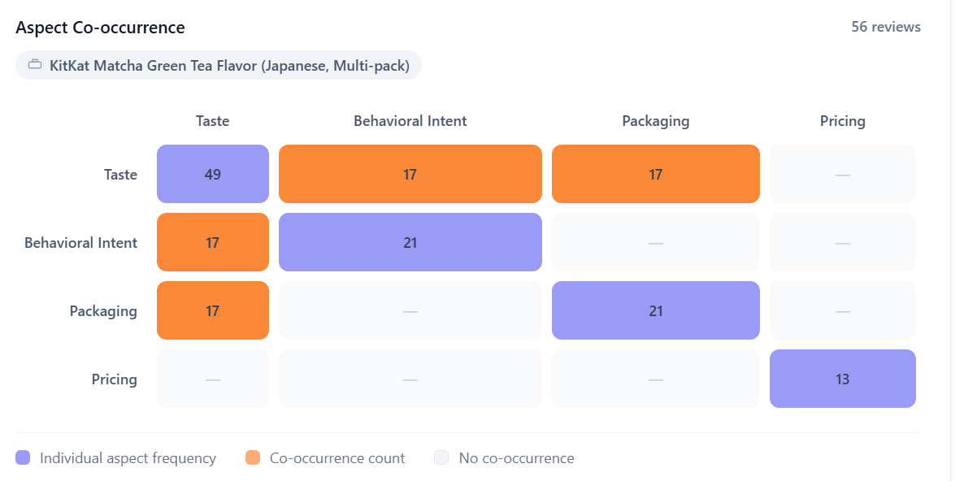
Multi‑Layer Aspect Analysis: Trends, Co‑Occurrence & Prioritization
Sentiment Trend Analysis
Tracks sentiment trends over time for each aspect, providing insights into how customer opinions evolve.
Visualizes trends using line charts, enabling stakeholders to identify patterns and changes in sentiment.
Aspect Co-occurrence Analysis
Identifies pairs of aspects frequently mentioned together in the same review, highlighting potential interdependencies or correlations.
Visualizes co-occurrence data as a heatmap, making it easy to interpret relationships between aspects.
Aspect Importance Scoring
Calculates the frequency of mentions for each aspect and normalizes it to derive an importance score.
Visualizes aspect importance using bar charts, helping prioritize aspects based on customer feedback.

Slide 9
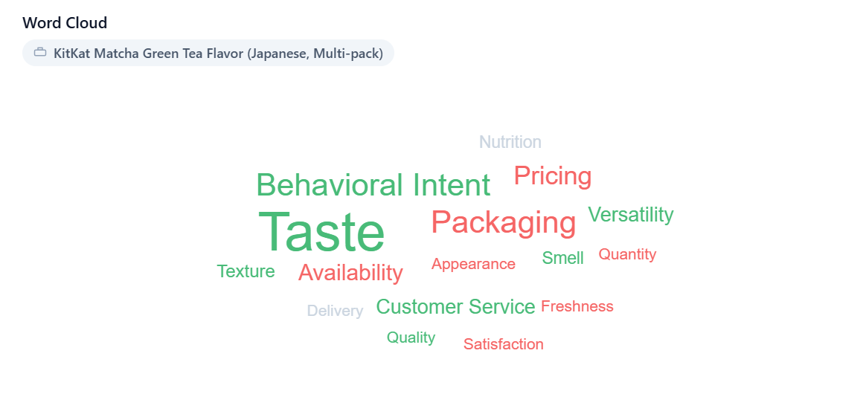
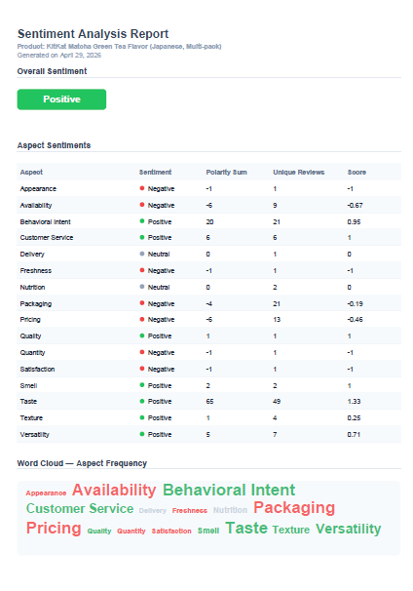
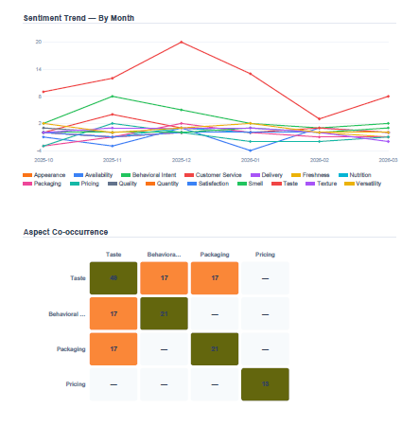
Comprehensive Sentiment Visuals: Comparison, Clouds & Reports
Sentiment Word Clouds
Creates word clouds for positive, neutral, and negative sentiments, highlighting frequently used words in customer feedback.
Uses sentiment-specific color schemes to enhance interpretability and visual appeal.
Report Generation
Provides detailed reports on overall sentiment distribution and aspect-wise sentiment distribution.
Uses charts and structured data to summarize insights, making it easier for stakeholders to understand and act on the findings.

Slide 10
Evidence‑Backed Insights: RAG’s Transformation of ABSA( Future Scope )
Transforms opinions into evidence‑backed product insights.
Validates sentiments through peer‑reviewed evidence and citation workflows.
Normalizes claims and checks them against scientific and regulatory sources.
Enhances competitive benchmarking through enriched aspect intelligence.
Compares aspect sentiments with competitors and identifies differentiating gaps.
Strengthens compliance via automated claim verification workflows.
Flags unsupported claims using regulatory guidance and scientific validations.
Accelerates product innovation with evidence‑linked sentiment drivers.
Converts negative sentiment clusters into research‑backed formulation improvements.
Enables persona‑specific insights for targeted product decisions.
Segments sentiment using persona inference and ontology‑driven aspect mapping.
Reduces hallucinations using retrieval‑anchored generation safeguards.
Enforces citation‑mandatory outputs and rigorous retrieval‑based truth checks.
Provides defensible insights grounded in structured evidence and sentiment data
Improves claim accuracy with research‑validated sentiment grounding.
Boosts decision confidence with citation‑supported recommendations.

Slide 11
RAG Enhanced Framework for Sentiment Analysis
Data Sources • Reviews • Product Metadata • Research Papers
Indexing & Retrieval • BM25 • Vector DB • Reranker
LLM Layer • Aspect Extraction • Sentiment Attribution • RAG Answerer
Compliance & QA • Compliance Checker • Faithfulness Evaluator
Ops • Monitoring • Redaction

Slide 12



Getting to the
future, faster. Together.

